Slide 1

Module 9: ChIP-sequencing
Presented by:
Alejandra Medina-Rivera
Laboratorio Internacional de Investigación sobre el Genoma Humano
Universidad Nacional Autónoma de México
amedina@liigh.unam.mx
@AleMedinaRivera
Based on materials by:
Daniel Gaffney
Next Generation Sequencing Bioinformatics Course
22-27 January 2023 - Santiago - Chile
FACULTAD DE
CIENCIAS BIOLOGICAS
PONTIFICIA UNIVERSIDAD CATÓLICA DE CHILE

Slide 2
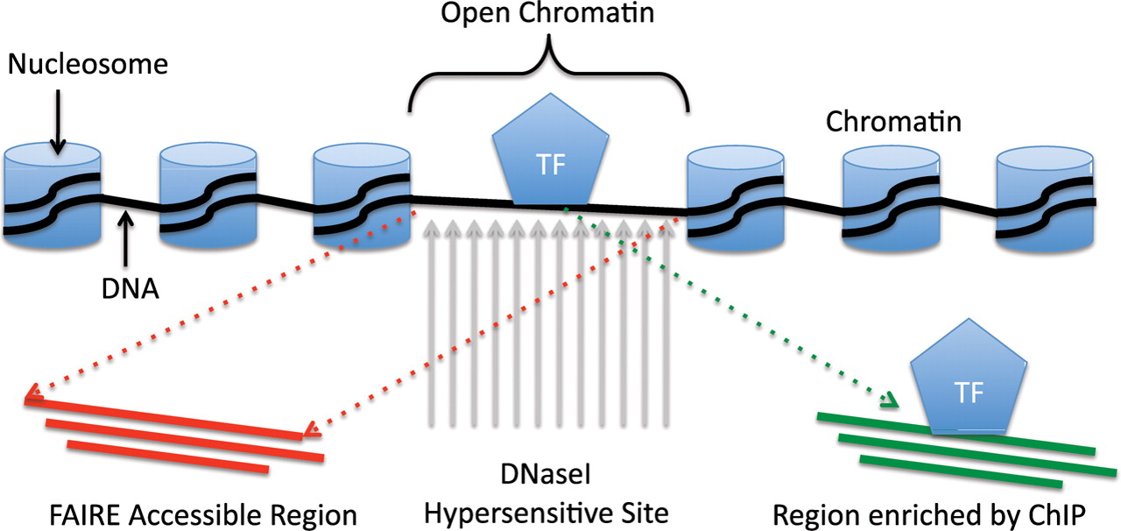
Epigenetics/ChiP in one slide
Regulation of transcription involves interaction of protein and DNA
Notes:
This is an informatician’s view of epigenetics:
NUCLEOSOME:
Chromatin = complex of DNA and nuclear proteins.
DNA is condensed by being wrapped around HISTONES = nuclear proteins.
The repeating DNA/Histone complex (8 proteins) = NUCLEOSOME
Tightly packed chromatin = heterochromatin = harder for DNA binding proteins to access DNA.
Loosely packed = euchromatin = DNA accessible for transcription
TF:
Transcription factors are proteins that bind to DNA (in euchromatin) to regulate expression via a variety of mechanisms:
stabilize or block binding of RNA Pol
Modify histones to make it bind to DNA more weakly / more strongly, making it more or less accessible to transcription
Epigenetic modification to histon proteins (methylation, acetylation) can alter structure of chromatin => more transcriptional activation or repression.
Recruit other proteins into a complex
DNAS1 Hypersensitive site.
DNaseI is an endonuclease. It will degrade DNA more readily at open chromatin regions, which also should coincide with where TFs are binding.
Region Enriched by CHIP:
CHIP in one sentence will enrich and sequence open chromatin regions where TFs are binding.

Slide 3
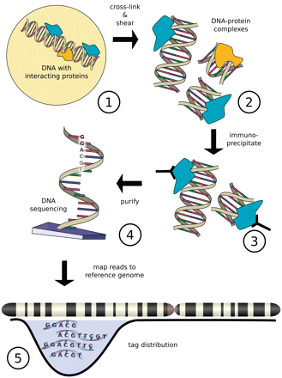
How does ChIP-seq work?
Antibody
Notes:
Protein of interest is CROSS-LINKED with DNA site it binds to using formaldehyde fixation.
Cells are lysed and DNA is sheared => small (<=1k) double-stranded chunks of DNA, including DNA in a Protein / DNA complex.
An antibody specific to POI is used to bind to protein and then filter out ONLY the bound antibody-protein-DNA-complex. Purify either with attaching AB to solid surface, or magnetic beads.
Note: you can tag the POI and use an antibody against the tag, or use an AB against native protein.
Reverse cross-linking of protein to DNA, convert to single-strand DNA
Sequence the SS DNA.
Find out where the peaks of the sequences are

Slide 4
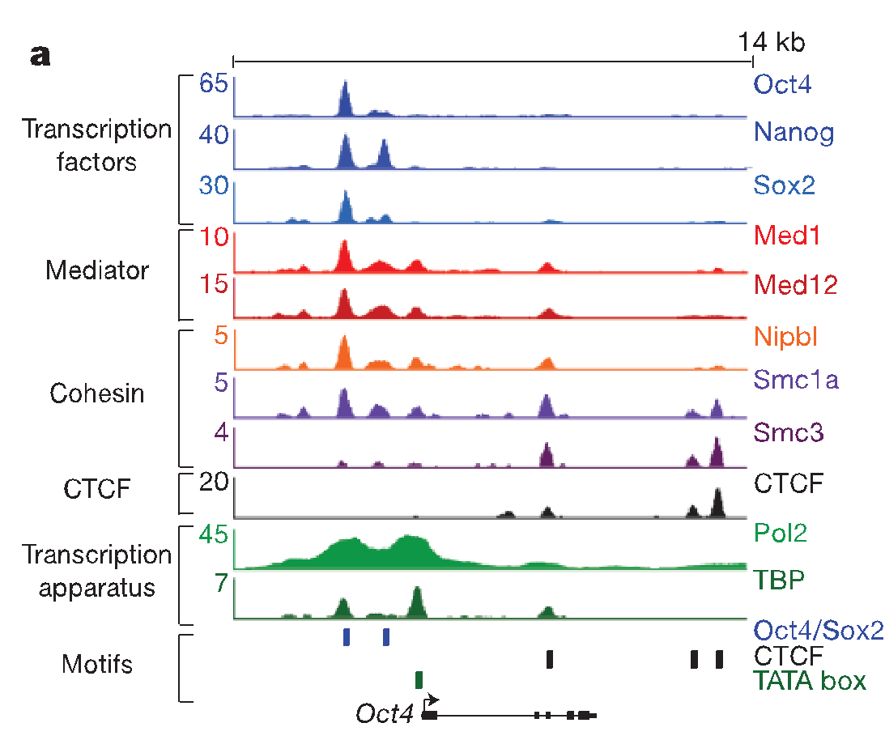
What does ChIP-seq look like?
A statistical procedure (peak calling) is used to call regions of enrichment (peaks)
Can use a control “Input” sample as a background
Peak calling quality varies dramatically by quality of the ChIP-seq
Notes:
The result of sequencing the fragments of DNA which were cross-linked to a protein-of-interest are a set of sequence fragments!
You expect those fragements to be concentrated to where the proteins were binding, and indeed, if you look for the pileups of fragments, you’ll find them co-located with proteins.
This is the results of many different CHIPSeq runs, showing peaks in the region of Oct4:
There are transcription factors, mediators, cohesins, CTCF: these have relatively narrow peaks compared to the Pol and TBP peaks: they are broad

Slide 5
Applications of ChIP-seq
ChIP-seq is one of the most commonly used approaches for identifying gene regulatory regions
Two common types:
Transcription factors
Histone modifications

Slide 6
ChIP-seq for transcription factors
Each of these TFs requires a high quality, ChIP-grade anti-body
Most antibodies (~60%) are not good enough for ChIP-seq
Notes:
There are a wide range of proteins that bind to DNA, and they have different binding profiles.
If you put them next to each other, you can see the differences:
TF:
Transcription factors are proteins that bind to DNA (in euchromatin) to regulate expression via a variety of mechanisms:
stabilize or block binding of RNA Pol
Modify histones to make it bind to DNA more weakly / more strongly, making it more or less accessible to transcription
Epigenetic modification to histon proteins (methylation, acetylation) can alter structure of chromatin => more transcriptional activation or repression.
Recruit other proteins into a complex
So you expect narrow peaks around the 5’ TSS, and indeed this is what we’re seeing.
These sorts of peaks are around the TSS. Other proteins are are not necc. clustered around TSS.
Mediator: MED1, MED12: transmit signals from the TF to the Polymerase
Cohesin: responsible for sister chromatid cohesion.
CTCF: it does _everything_. regulates the 3D structure of chromatin. Can act as a transcriptional activator or repressor.
Pol2, TATABindingProtein. Big signals.

Slide 7
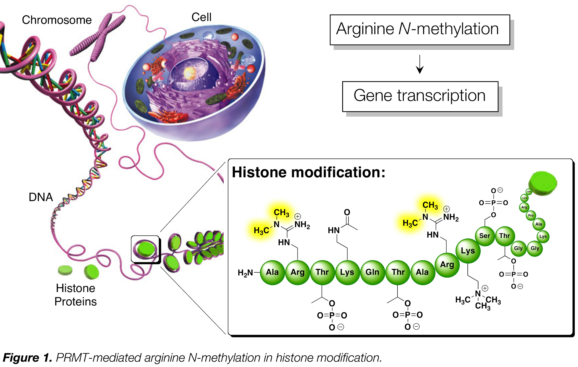
Histone modifications
Antibodies can also be made against histone modification
Notes:
HISTONES: proteins forming the nucleosome.
So histone / DNA interaction is critical in determining whether the chromatin is open or closed.
Histone code hypothesis:
Chromatin / DNA interactions are guided by combinations of histone mods.
What is a histone mod?
There are a number of different histone proteins (subtypes of the family H1 – H4) which form the nucleosome. Mods to residues in the H3 and H4 family are the best understood.
You can get antibodies against specific modifications, so you can do chipseq to localize on the genome WHICH mods are in effect in particular cell types and states.
Result: There is a catalog of possible mods, and their significance.

Slide 8
Histone mark cheat sheet
Histone mark | Candidate State | Interpretation
H3K9me2,3 | - | Silenced genes
H3K27me3 | Inactive/poised promoter, polycomb repressed | Downregulation of nearby genes
H3K36me3 | Transcriptional transition | Actively transcribed gene bodies.
H4K20me1 | Transcriptional transition | Transcriptional activation
H3K4me1,2,3 | Strong enhancer | Promoter of active genes
H3K27ac | Active promoter/strong enhancer | Active transcription
H3K9ac | Active promoter | Switch from transcription initiation to elongation.
Notes:
So here is the actual KNOWLEDGE of the transcriptional effect of any particular histone mod.

Slide 9
EPIGENETIC JARGON CHEAT - SHEET
Regulatory Element | Meaning
Promoter | DNA Sequence (100-1kb), initial secure binding site for: RNA Pol complex Transfacs Adjacent regulated gene, defined relative to TSS. Poised: simultaneous activation/repressive histone mods.
Enhancer/Silencer | DNA Seq (50-1.5kb), bound by transfacs (activator / repressor) Can act on gene up to 1Mb away: DNA folding brings it close to promoter. Enhancer: Bound by activator, which interacts with complex initiating transcription. Silencer: bound by repressor, which interferes with GTF assembly.
Insulator | DNA, 300-2kb, Block enhancers from acting on promoters: positioned between enhancer and promoter, form chromatin-loop domains.
Polycomb-repressed | Polycomb – group proteins actively remodel chromatin to silence genes.
Notes:
But first, a quick review of some epigenetic terminology: this will help with the table that’s about to come…

Slide 10
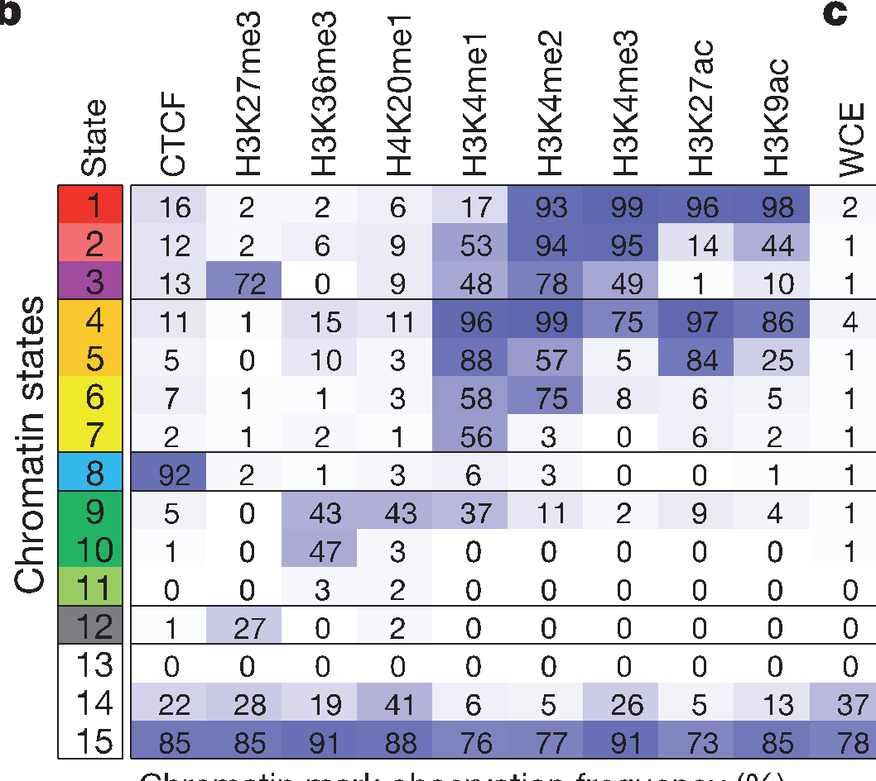
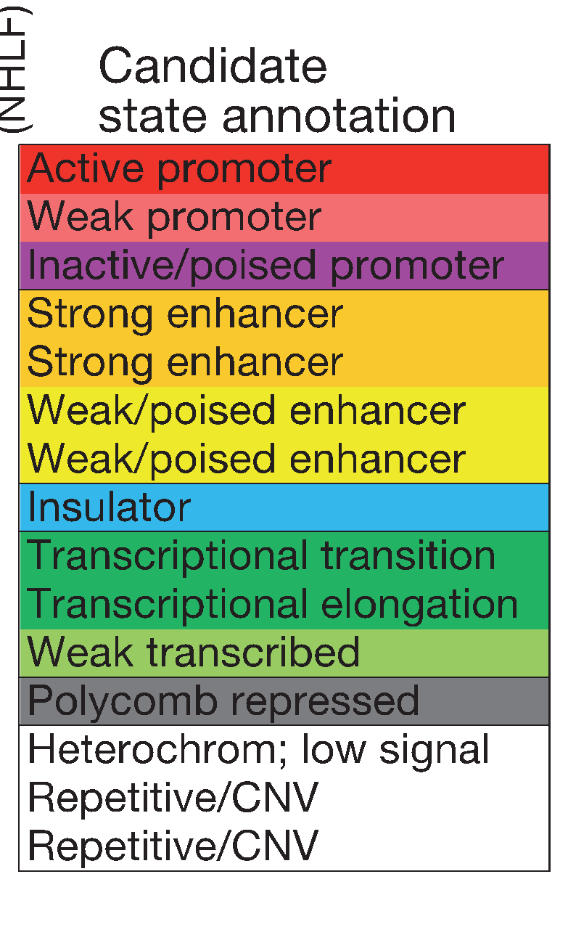
The histone code
First: create these categories by applying HMM classifying stretches of genome to combined peak data:
9 cell lines x 9 chromatin marks. Apply functional interpretation after categories are created.
Then: go back and ask what fraction of classified regions contain peaks of a given type.
Ernst et al 2011
Notes:
Given those terms, I can put up a table like this.
The right table is a set of regulatory CLASSES, which were found by taking 9 cell types with CHIPSEQ for 9 different kinds of epigenetic mod
And scanning across the genome, classifying the genome ab-initio into these groups.
The table shows the evidence that these classes of histone mods are distinct.
The actual function of the groups was bolted on afterwards by just knowing what each of these histone mods did.

Slide 11
Histone mark cheat sheet
Histone mark | Candidate State | Interpretation
H3K9me2,3 | - | Silenced genes
H3K27me3 | Inactive/poised promoter, polycomb repressed | Downregulation of nearby genes
H3K36me3 | Transcriptional transition | Actively transcribed gene bodies.
H4K20me1 | Transcriptional transition | Transcriptional activation
H3K4me1,2,3 | Strong enhancer | Promoter of active genes
H3K27ac | Active promoter/strong enhancer | Active transcription
H3K9ac | Active promoter | Switch from transcription initiation to elongation.
Notes:
So here is the actual KNOWLEDGE of the transcriptional effect of any particular histone mod.

Slide 12
ChIP-seq experimental considerations
Antibody quality: 60% of antibodies not high enough quality
Numbers of cells: 2-3M recommended, more for TFs (5-10M)
Crosslinking time: ~10 mins
Shearing
Notes:
So now I turn to desired experimental conditions:
These are simply relayed to me by a biologist (Dan Gaffney) so I will relay them to you!
Make sure your antibodies are of high quality!
That you have enough cells! And that you cross-link DNA and protein for long enough!
And that you shear to get the right fragment size:

Slide 13
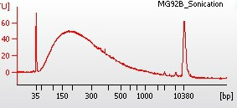
Shearing
Aim for fragments in 150-400bp range
Efficiency varies by cell type
Optimise by varying number of shearing cycles
Run input samples on Bioanalyser to check efficiency
Notes:
You can check the fragment size with bioanalyser: you want 150-400bp fragments
Read alignment:
Effect of read length on SE/PE on alignment rates:
Longer SE read aligns more unique better than short SE read (increase from 50=>75, say)
Paired more unqiue than single, IF read length is constant. BUT if you make the PE longer, THEN align rate drops off: drop in quality at 3’ end.
Longer reads: better coverage over repetetive regions.
PE design: better coverage over repetetive regions.
Peak numbers:
PE more than SE (approx. 10^5 peaks) – because more reads!
Read length: no impact on numbers of peaks.
PE => better IDR

Slide 14
ChIP-seq technical issues
Signal / noise: Does my antibody work?
Library complexity: Did I have enough starting material?
Notes:
Turn to two checks of CHIPSeq signal:
S/N
And
Library complexity

Slide 15
Signal / noise
Noise (background)
Signal
Notes:
Signal is sequenced DNA which has bound to the protein you want.
NOISE is DNA that you don’t want also being included in the sequencing.
This may be because you pull down protein you weren’t expecting which is also cross-linked.
So it’s an indicaition of whether your antibody is specific enough.

Slide 16
Signal / noise
Signal
High signal/noise
Noise
Noise
True binding site
Signal
Low signal/noise
Noise
Noise
True binding site
Notes:
The b/g is an indication of S/N – put up two examples, one of low b/g and one of high b/g

Slide 17
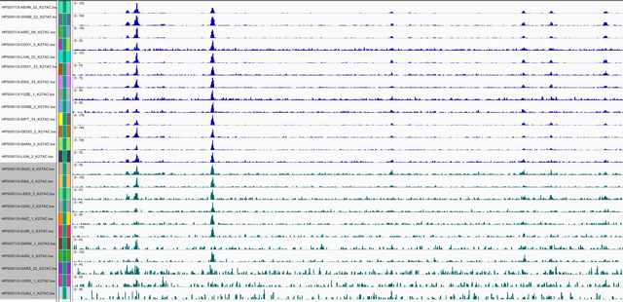
Signal-to-noise
High background
Notes:
And in real life, this shows many different tracks: you can see the high-bg (noise) tracks

Slide 18
FRIP
Fragments In Peaks
# Fragments found in peaks / Total # fragments
>1%
Notes:
FIRST CUT measure of success of IP.
So, generally, once way of checking how good your peaks are relative to the b/g is to check Fragments in Peaks, relative to total # of all fragments: this should be >1%
This is an ENCODE guideline.
Generally, FRIP increases linearly with numbers of called peaks. FRIP works when there are ~thousands – 10’s thousands of called sites.
Empirically:
You can use FRIP to compare performance of the SAME antibody in different conditions / cell lines.

Slide 19
Library complexity
Problem: Not enough starting material
Not enough cells
Antibody efficiency
More PCR required

Slide 20
Library complexity
Signal
High complexity
Noise
Noise
True binding site
Signal
Low complexity
PCR duplicates
Noise
Noise
True binding site

Slide 21
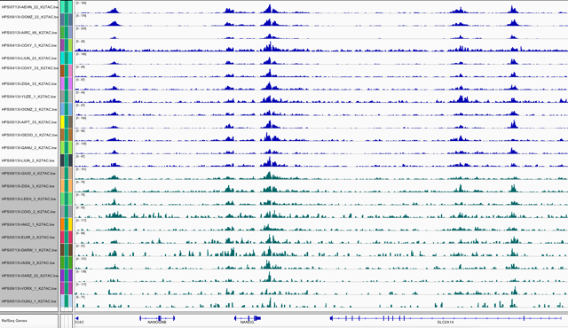
Library complexity
Decreasing complexity

Slide 22
Nonredundant fraction
# unique fragments positions / total # fragments
>0.8
Notes:
Goal: obtain > 10m reads per replicate.
Complexity metric: fraction of nonredundant mapped reads = NRF =
#number of unique positions in genome / total number of reads.
Want NRF >= 0.8 for 10 million uniquely mapped reads.

Slide 23
Basic analysis of ChIP-seq
Read alignment
Visualisation
Peak calling
Peak annotation (mapping peaks to genes etc)
Motif analysis
Differential binding
Case / control
Naïve / stimulated

Slide 24
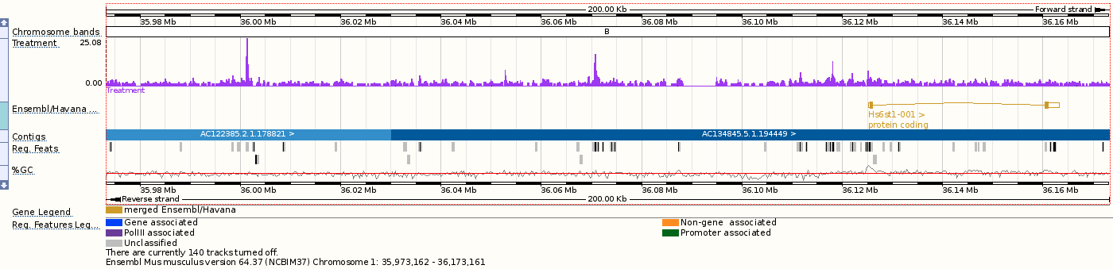
Visualisation in a genome browser
Convert mapped reads to “signal” – e.g. read depth at each bp or in windows
BAM files to e.g. wig, bedgraph
IGV, ensembl, UCSC

Slide 25
Peak calling
Sliding window
-log10(pval)
P-value threshold (FDR corrected)
peak
Observed counts
Expected counts
Poisson test: p-value – prob(observing frag count at least as extreme under null)

Slide 26
Peak calling challenges
What’s expected?
Treatment sample (with antibody)
Input sample (no antibody)
Replicates
Yes! (min 2, more = better)
Peak sizes
These are variable: small for TFs, large for some Histone mods, and for Pol2 etc.
Notes:
The INPUT to a peak caller is:
Trreatment bam file
Control bam file

Slide 27
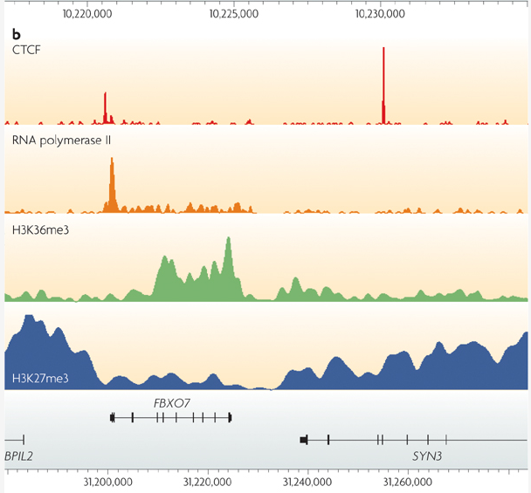
Park J, Nature Reviews Genetics, 2009
Notes:
What are the outputs?
These are fold-changes from a MACs run.
Notice that the size of the peaks are different from sample to sample:
Transfacs are sharp,
POL2 is low and spread out
H3K36m3 – medium size broad peaks: transcription elong over gene body
H3K27m3 – Polycomb repressor

Slide 28
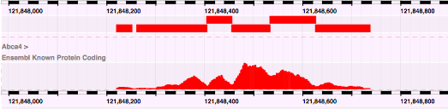
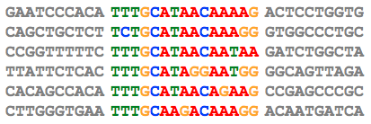
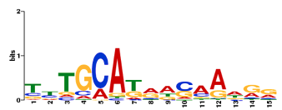
Motif analysis
Align sequences from multiple peaks
Discover motifs

Slide 29
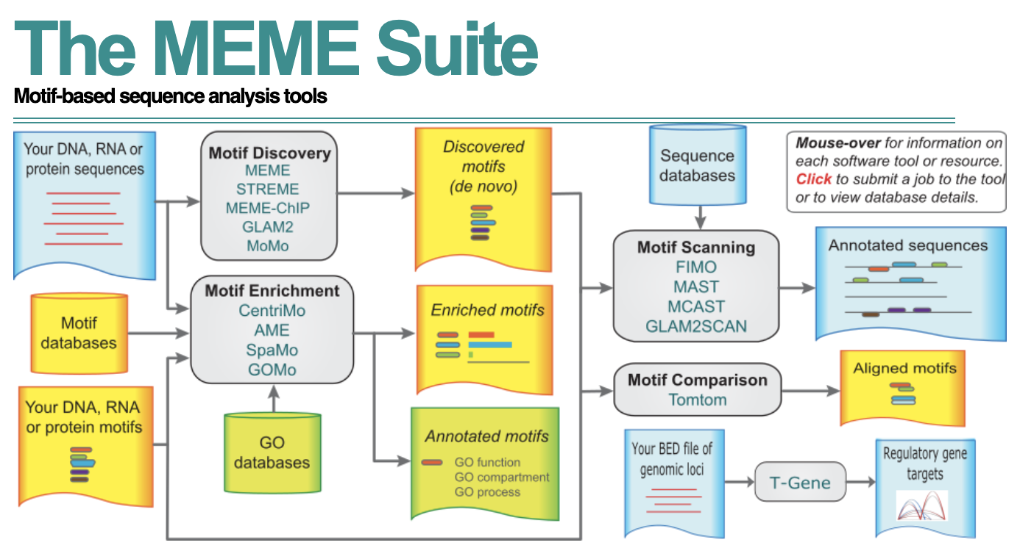
Motif analysis tools

Slide 30
Motif analysis tools

Slide 31
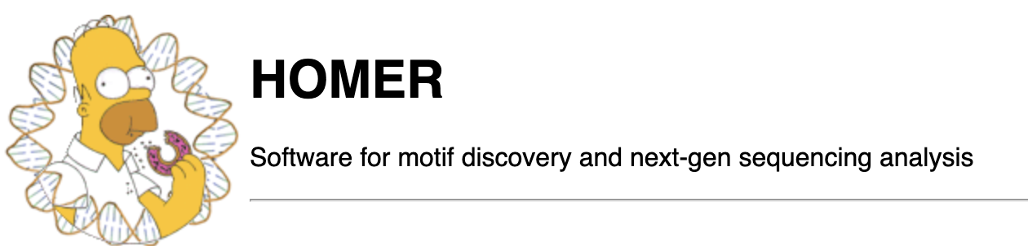
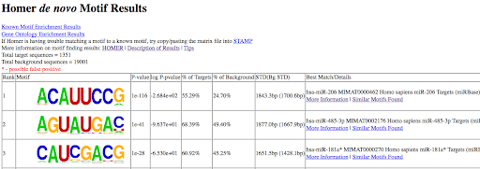
Motif analysis tools

Slide 32

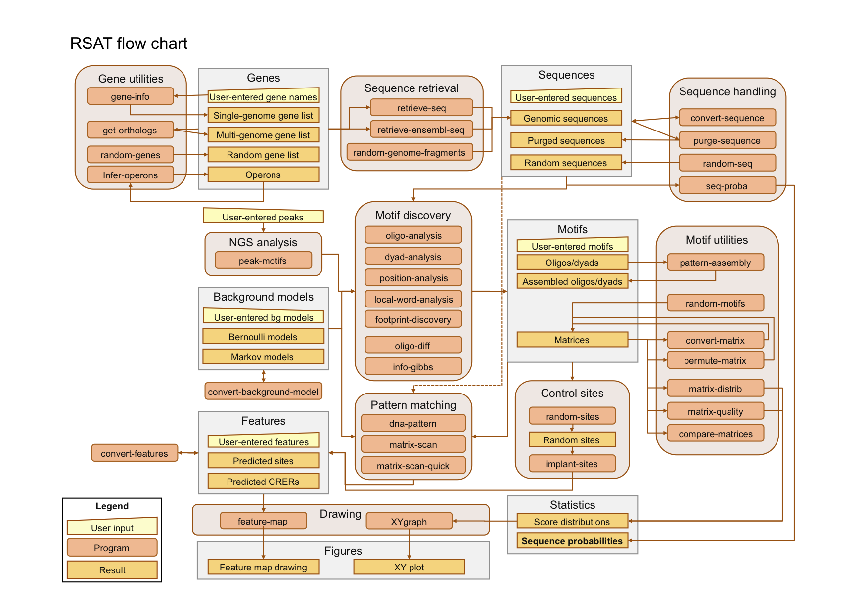
Motif analysis tools

